Slide 1
Insulin signaling pathways in Age-related locomotor impairment
Min Im

Slide 2
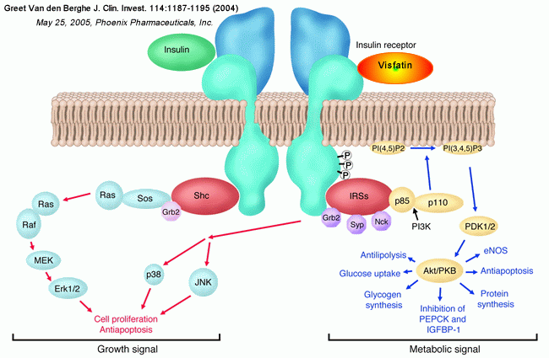
What is insulin signaling?
Insulin
  Hormone that regulates amount of glucose in the blood
  Triggers the uptake of glucose, fatty acids, and amino acids into liver and stores them in forms of glycogen, lipids, and proteins
Insulin Signaling
  A communication between the insulin receptors and receptor substrate proteins
Insulin signaling pathway
  Coordinated pathway to regulate glucose, lipid, and proteins

Slide 3
What is ARLI?
Age-related Locomotor Impairment
  A decrease in muscle mass and body movement due to aging
  Patients with ARLI are at greater risk for falling, skeletal fractures, obesity, diabetes, hypertension, and more
How can we contribute to society in order to help patients with ARLI?
  Develop better treatments!
  Unfortunately, little is known about the genes and genetic pathways that influence ARLI
So we need more experiments!

Slide 4
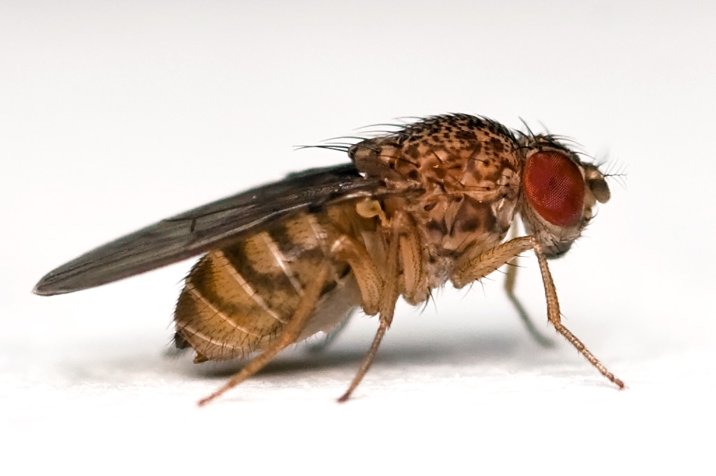
However…
Performing an aging-related experiment in human will take VERY VERY LONG time……..
Instead…
we use fruit flies, Drosophila!
Credit: Wikipedia

Slide 5
Why Drosophila?
Commonly used Model Organism
Small and easy to grow in labs
Complete genome is sequenced and published in 2000!
Recognizable similarities between human and Drosophila
Short lifespan
  Average of 30 days
  possible to evolve many generations

Slide 6
In Previous studies
Jones et al (2009) claimed that insulin signaling is a key regulator of ARLI in Drosophila
  They identified insulin signaling genes that delayed ARLI
    PDK1, Dp110, Akt
    Phosphoinositide 3-kinase (PI3K) insulin signaling pathway

Slide 7
Mitogen activated protein kinase (MAPK)

Slide 8

Therefore…
Proposal on Mitogen-activated protein kinase (MAPK) pathway to see if insulin signaling genes of MAPK pathway also influence ARLI

Slide 9

Experiment steps
1. Identify MAPK insulin genes: RAS, RAF, MEK, ERK1

Slide 10
Experiment steps
2. P-element insertion into an insertion site to create mutant groups
  A method used to insert P-element into an insertion site in order to create genetically modified flies
Where to insert?
  EP937, EP3553, BG02759, EP1150, DJ708, C00368, C02098

Slide 11
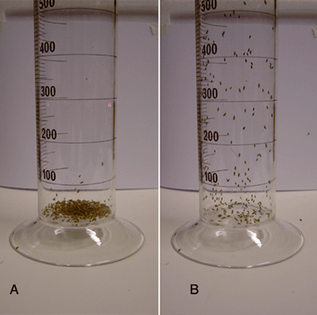
Experiment steps
3. Calculate Negative Geotaxis to compare results
  Geotaxis means walking against the gravity (or Climbing)
  Distance climbed at 4sec will be measured in weekly interval

Slide 12
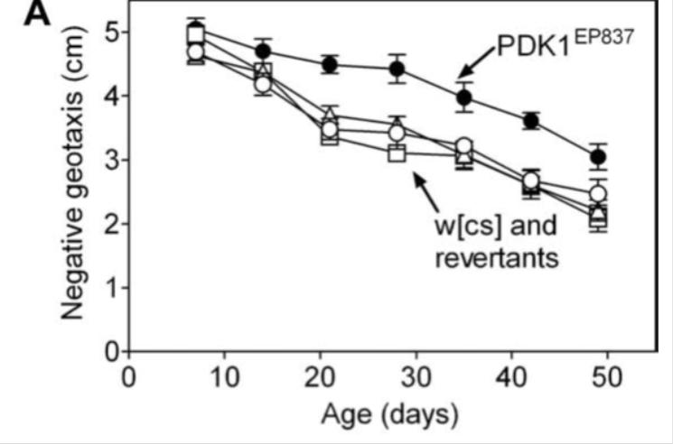
Experiment steps
4. Possible outcomes
  MAPK pathway insulin genes delay or accelerate ARLI
  Or Not affective at all

Slide 13
How is that experiment going to help?
Use insulin pathways as regulators of ARLI
Also, we can search for human gene homologues in flies from online database called Homophila!
If we could find human gene homologues, developing new treatment is matter of time!
In future, study insulin genes in depth

Slide 14
References
Arking, R., 1998. The Biology of Aging: Observations and Principles, second ed.Sinauer Associates, Sunderland, MA
Taniguchi, Cullen M., Brice Emanuelli, and Ronald Kahn. "Critical Nodes In Signalling Pathways: Insights Into Insulin Action." Nature Reviews Molecular Cell Biology 7.2 (2006): 85-96. Academic Search Complete. Web. 2 Dec. 2013.
Melanie A. Jones, et al. "A forward genetic screen in Drosophila implicates insulin signaling in age-related locomotor impairment."Experimental Gerontology. 44. (2009): 542-540. Web. 16 Oct. 2013. <http://www.ncbi.nlm.nih.gov/pubmed/19481596>.
Grotewiel, Mike, and Melanie A. Jones. "Drosophila as a Model for Age-Related Impairment in Locomotor and other Behaviors." Experimental Gerontology. 45(5). (2011): 320-325. Web. 16 Oct. 2013. <http://www.ncbi.nlm.nih.gov/pmc/articles/PMC3021004/>.
Rodenizer, Devin, Mike Grotewiel, et al. "Genetic and environmental factors impact age-related impairment of negative geotaxis in Drosophila by altering age-dependent climbing speed." Experimental Gerontology. 43(8).739-748 (2008): n. page. Web. 16 Oct. 2013. <http://www.ncbi.nlm.nih.gov/pmc/articles/PMC2591094/>.
Massimo Zeviani, et al. "Mutations In TTC19 Cause Mitochondrial Complex III Deficiency And Neurological Impairment In Humans And Flies." Nature Genetics 43.3 (2011): 259-263. Academic Search Complete. Web. 18 Oct. 2013.
Andrew G. Davies, Ryan I. Friedberg, Hersh Gupta, Chung-Lung Chan, Keith L. Shelton, Jill C. Bettinger, Different genes influence toluene- and ethanol-induced locomotor impairment in C. elegans, Drug and Alcohol Dependence, Volume 122, Issues 1–2, 1 April 2012, Pages 47-54, ISSN 0376-8716, http://dx.doi.org/10.1016/j.drugalcdep.2011.08.030. (http://www.sciencedirect.com/science/article/pii/S0376871611003905)
R. St. Laurent, L.M. O’Brien, S.T. Ahmad, Sodium butyrate improves locomotor impairment and early mortality in a rotenone-induced Drosophila model of Parkinson’s disease, Neuroscience, Volume 246, 29 August 2013, Pages 382-390, ISSN 0306-4522, http://dx.doi.org/10.1016/j.neuroscience.2013.04.037. (http://www.sciencedirect.com/science/article/pii/S030645221300362X) Ian Martin, Melanie A. Jones, Mike Grotewiel, Manipulation of Sod1 expression ubiquitously, but not in the nervous system or muscle, impacts age-related parameters in Drosophila, FEBS Letters, Volume 583, Issue 13, 7 July 2009, Pages 2308-2314, ISSN 0014-5793, http://dx.doi.org/10.1016/j.febslet.2009.06.023. (http://www.sciencedirect.com/science/article/pii/S0014579309004712)

